Slide 1
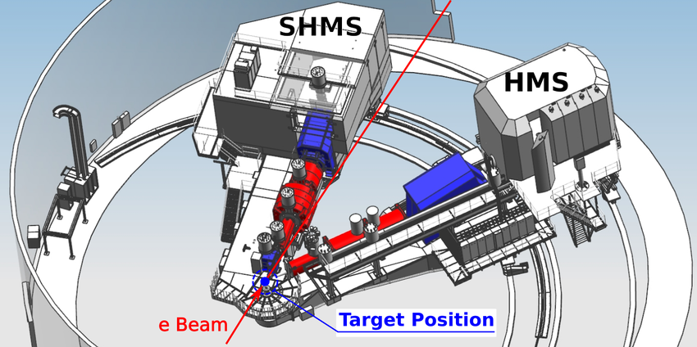
The Reaction
Deuteron coincidence reaction taking place in Jlab Hall C
Protons are detected in the High Momentum Spectrometer (HMS)
Electrons are detected in the Super High Momentum Spectrometer (SHMS)

Slide 2
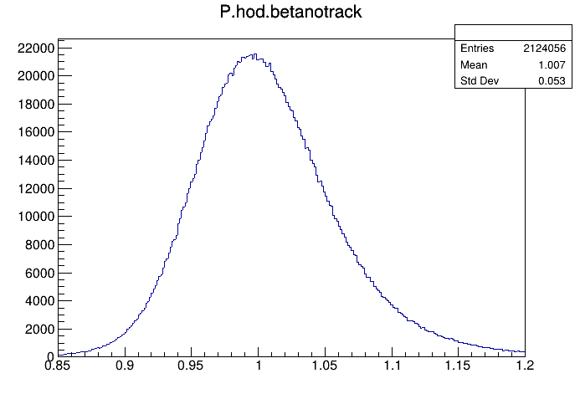

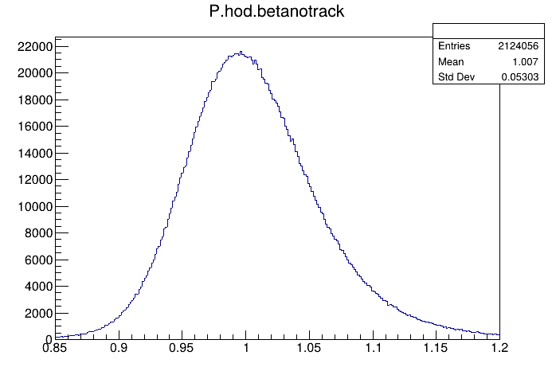
Uncalibrated
Time Walk Calibrated
Fully calibrated
Notes:
SHMS/electrons

Slide 3
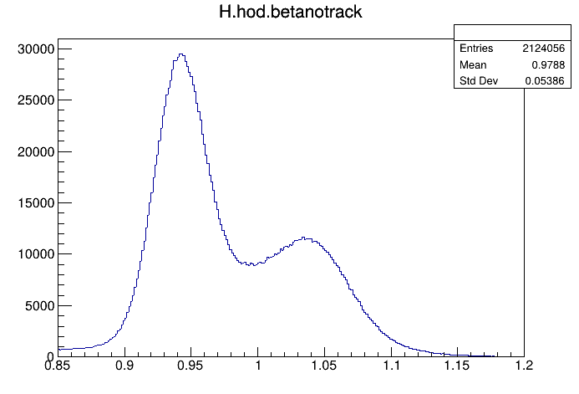

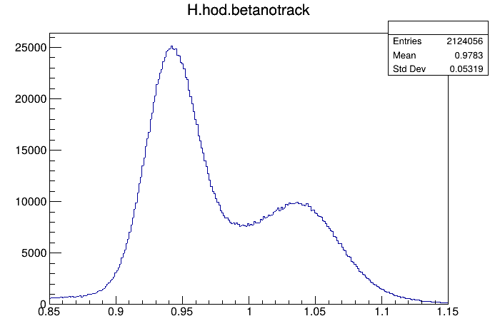
Uncalibrated
Time Walk Calibrated
Fully Calibrated
Notes:
HMS/Protrons

Slide 4
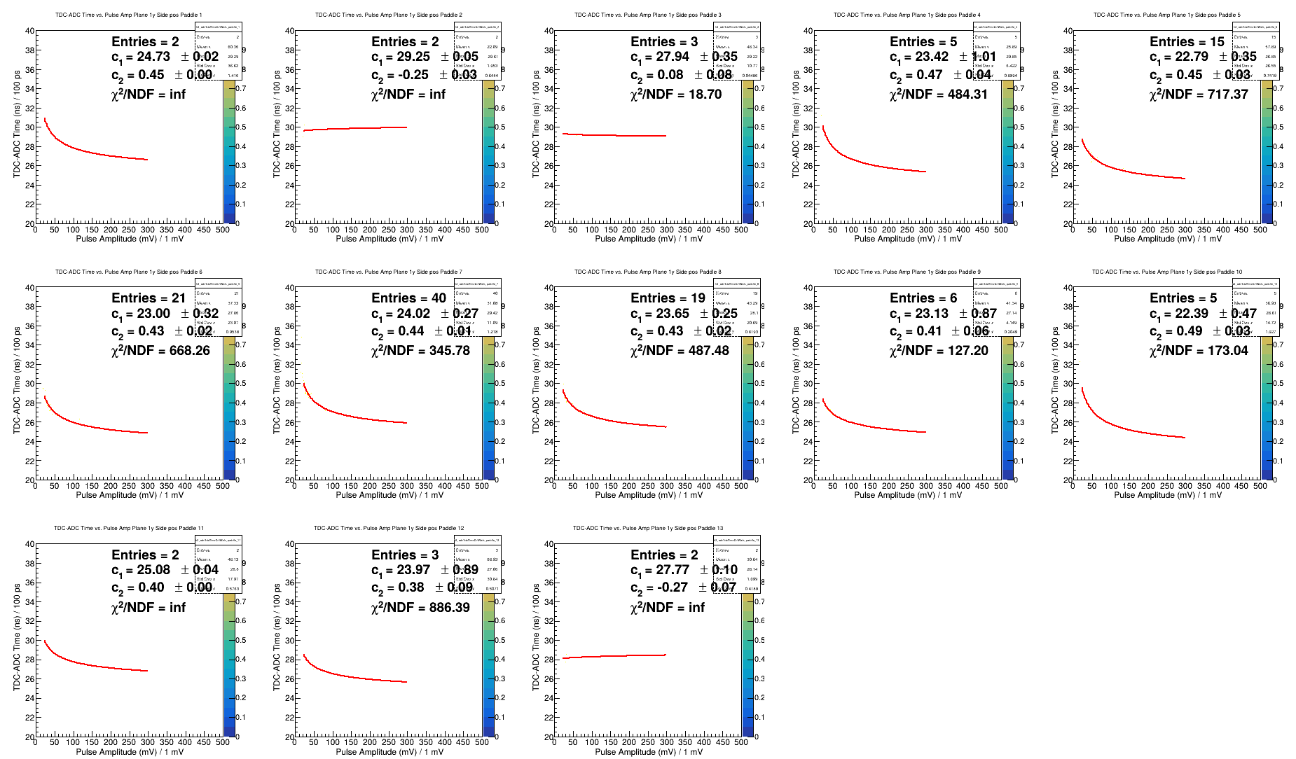

Slide 5
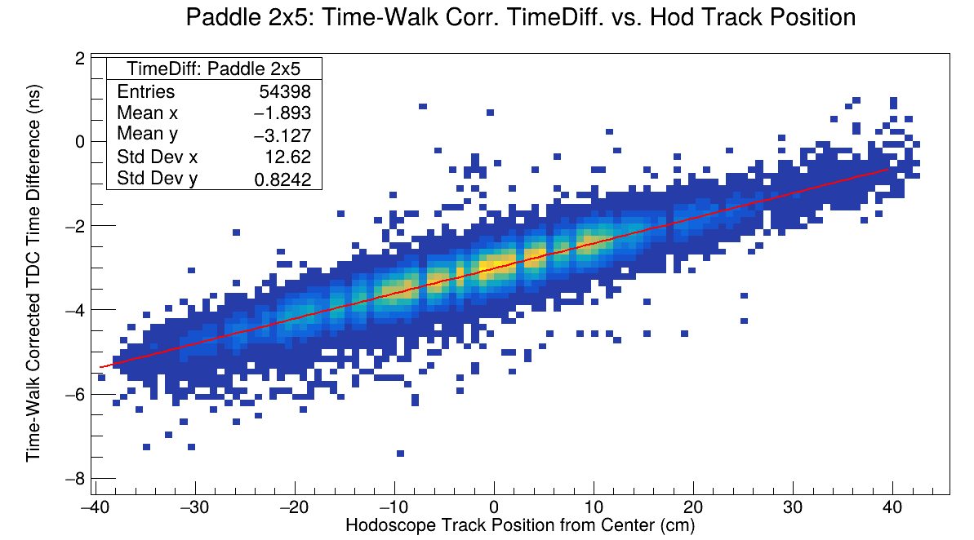
Notes:
SHMS

